Slide 1
“YingXao” Automatic EcoGardener
ECE 4872 Senior Design Project Proposal Presentation
Presenter: Yilun Chen, Yida Wang, Xi Li, Yihan Jiang

Slide 2
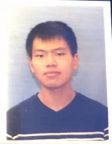



Meet Our Team
Hardware Lead: Yida Wang
Software Lead: Yihan Jiang
Project Manager: Xi Li
Documentation Admin: Yilun Chen

Slide 3
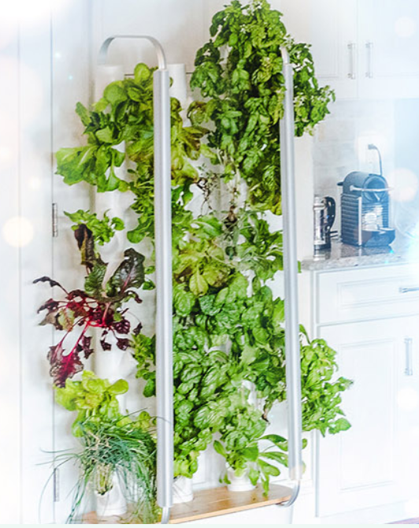
Motivation
Smart Gardening
Existing products:
Too expensive : $2,500+ per unit
Use artificial lighting. Not env-friendly
Too big. Not portable
We also want it to:
Constantly improve its gardening plans
Better user-plant interaction
https://mygardyn.com/

Slide 4
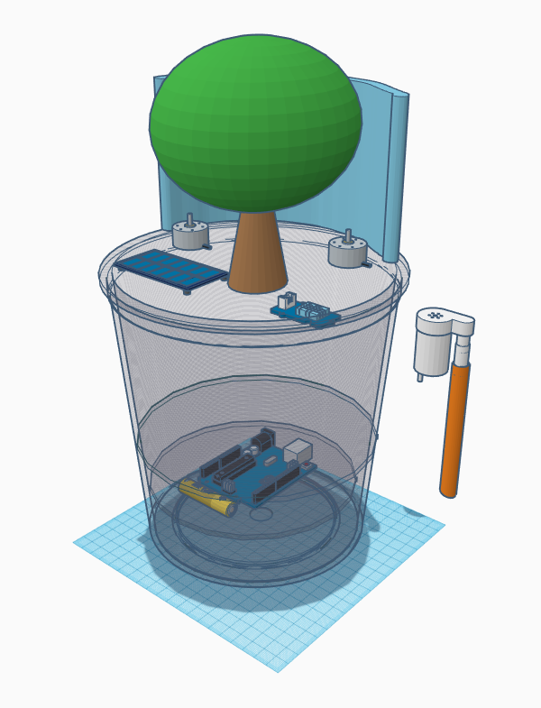
30,000 Ft High-level Design
Interplay of software and hardware
Physical Device
Interact with sensors and actuators
Cloud Service
Provides gardening plans
App
Provides an interaction/monitoring interface
Project goals
Users don’t need to take care of the plants themselves
Smooth and easy setup workflow
Unit cost below $100
Picture: Conceptual Design of YingXao

Slide 5
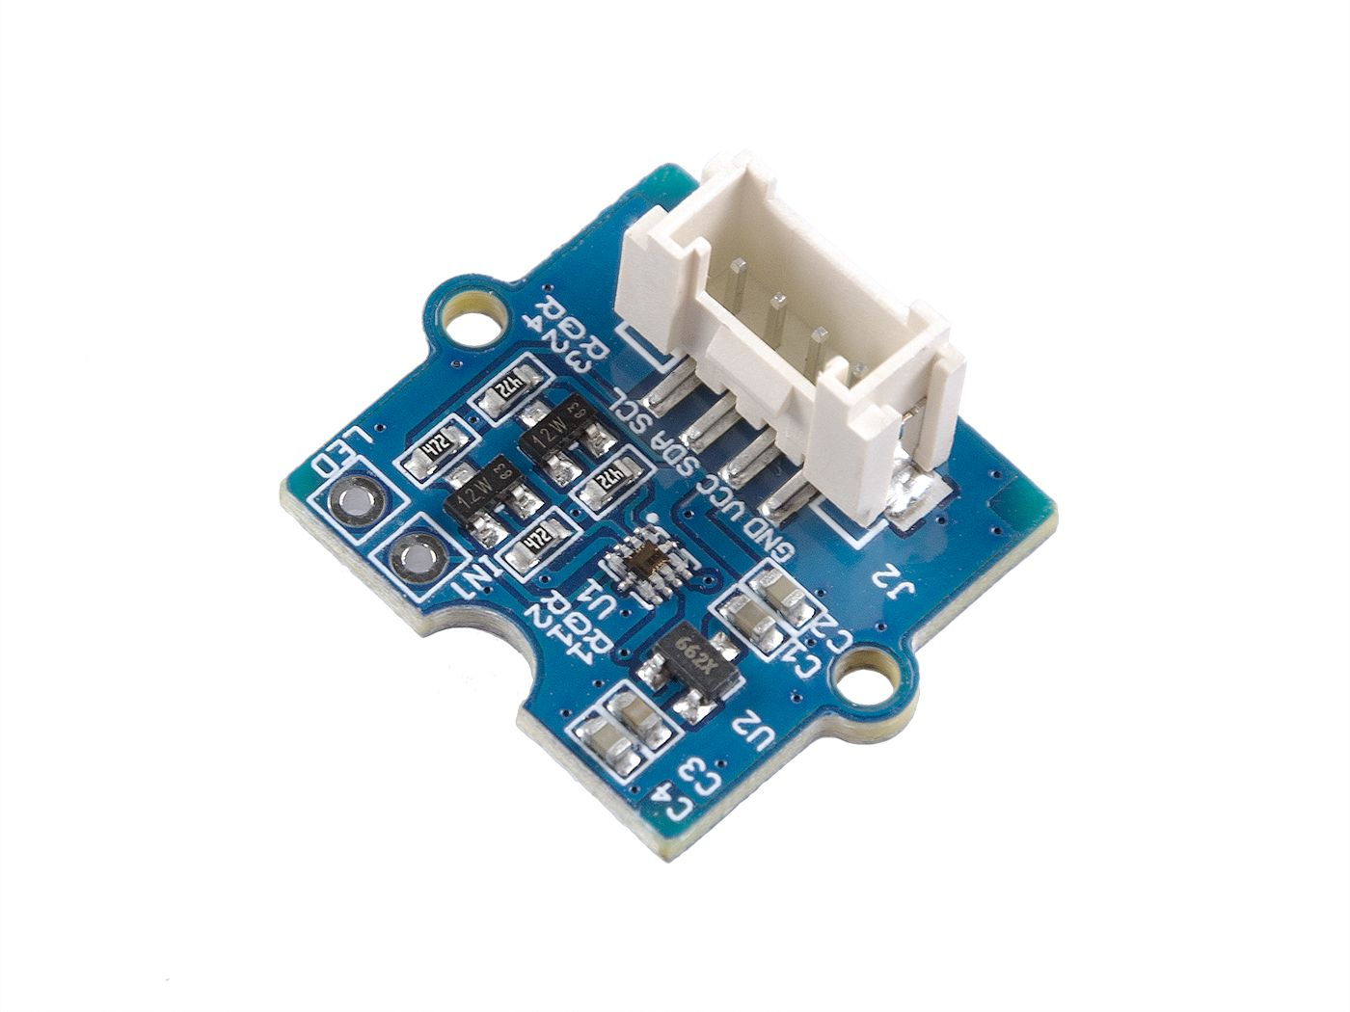
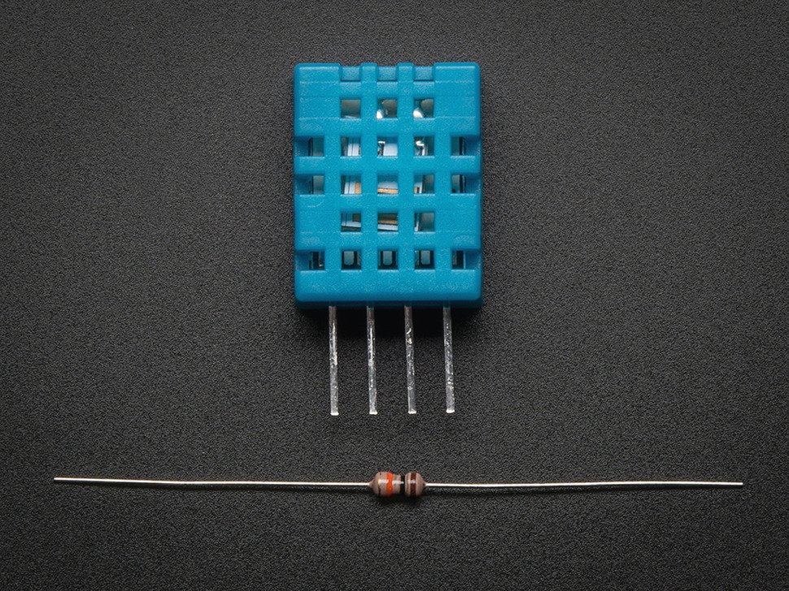
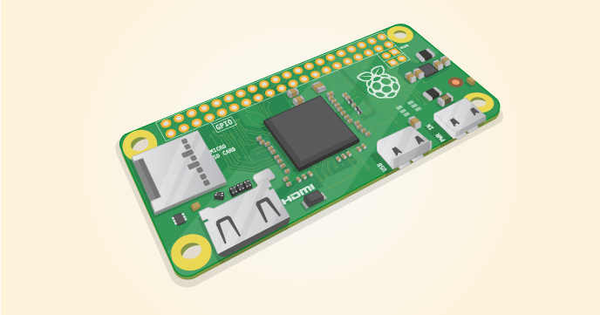
Tech Specs
Raspberry Pi Zero W
Fast processing speed, low cost and high compatibility
Bluetooth and internet
DHT11 basic temperature-humidity sensor
Ultra low cost and simply
Grove - Sunlight Sensor
Wide spectrum detection range and detect sunlight directly

Slide 6
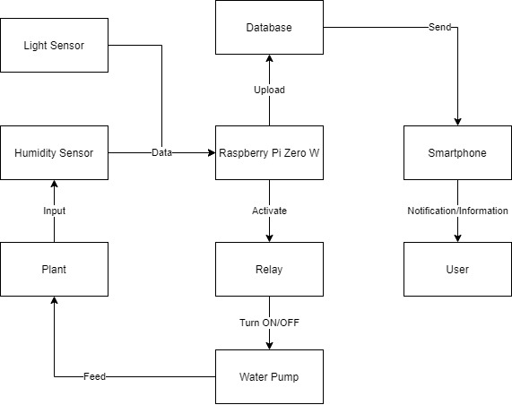
Design Approach
Sensing
Light and Humidity
Control
Pump and light blocking
Communication
Pi zero and App

Slide 7
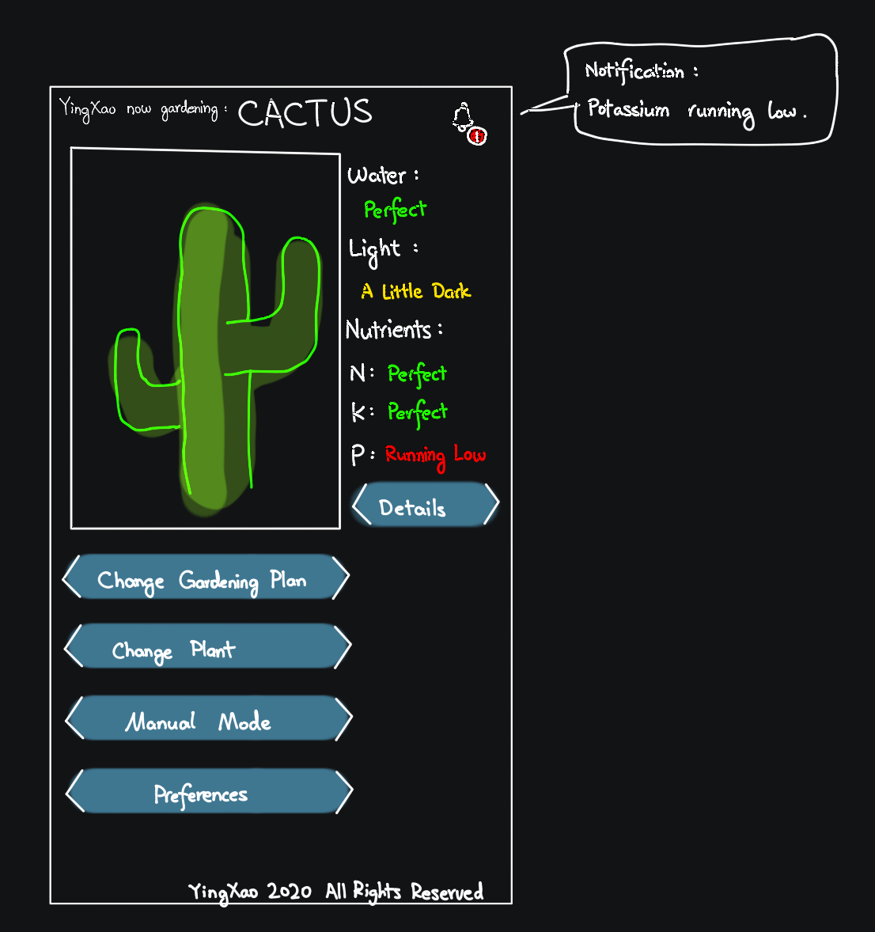
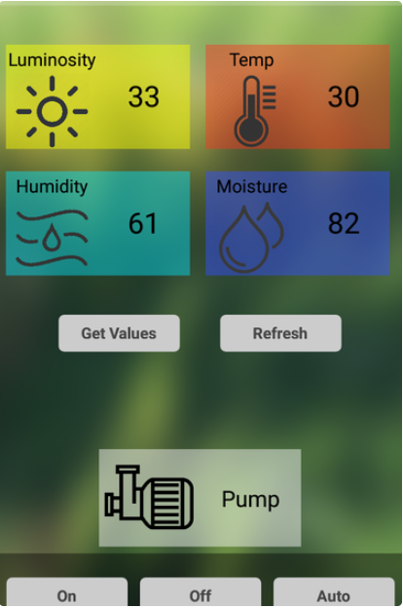
Conceptual UI of App
https://www.instructables.com/Raspberry-Pi-Powered-IOT-Garden/

Slide 8
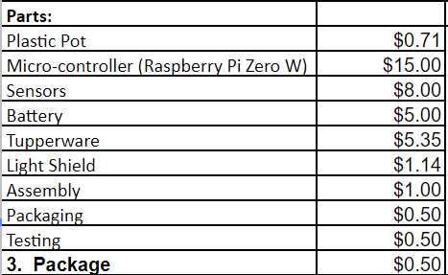
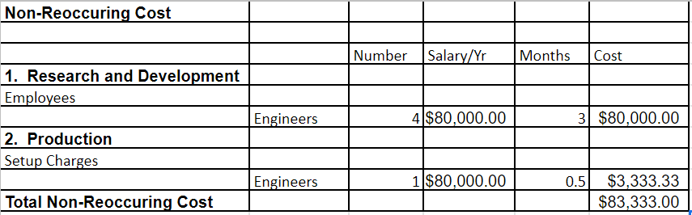
Cost
Target unit price: $100
Target sales volume / year: 2500 units
Cost / unit: $71.03
Profit / unit: $28.97
Total profit / year: $72425

Slide 9
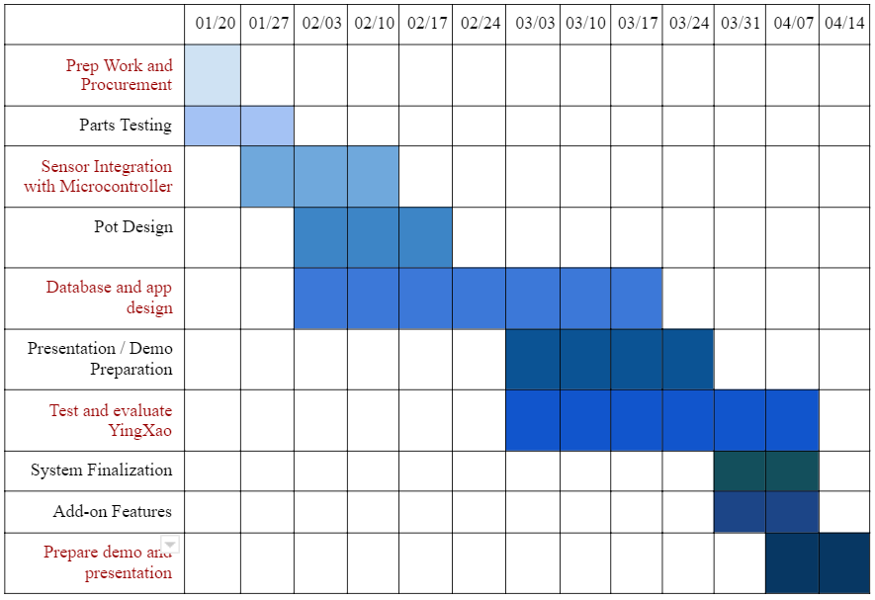
Schedules and Milestones

Slide 10
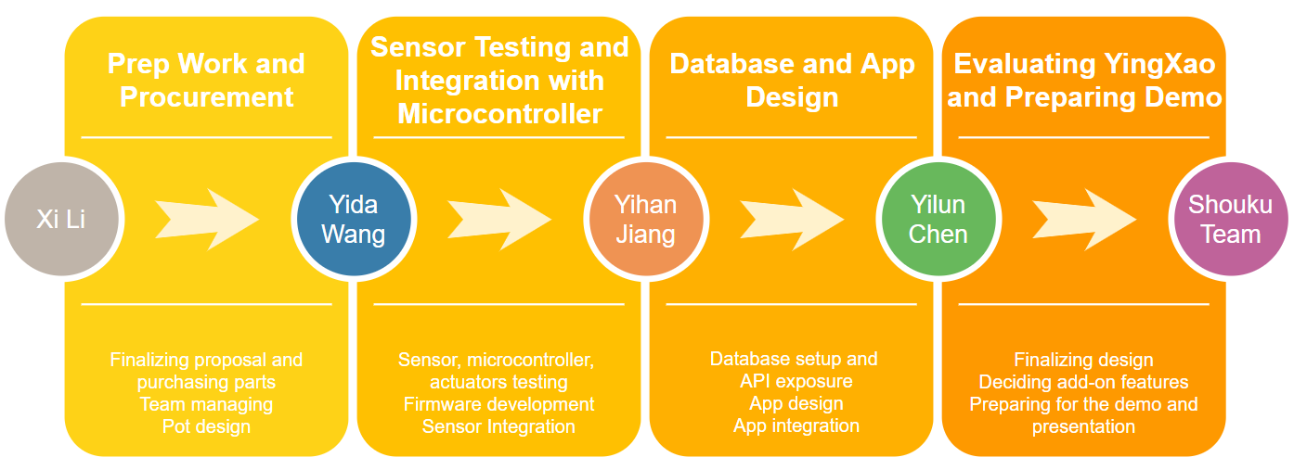
Critical Path

Slide 11


Project Demo
What will we present?
Physical body of the gardener & the app that monitors the gardener
How will we present?
Poster, Flyer -> Design overview and concept map
Live demonstration -> Specific functions
App Setting
Sensor Reading
Pump and Light Shielding
https://eu.clipdealer.com/vector/media

Slide 12
Thank you!

